Slide 1

ME 200 Thermodynamics
Lecture 12 – Typical Power Cycle

Slide 2
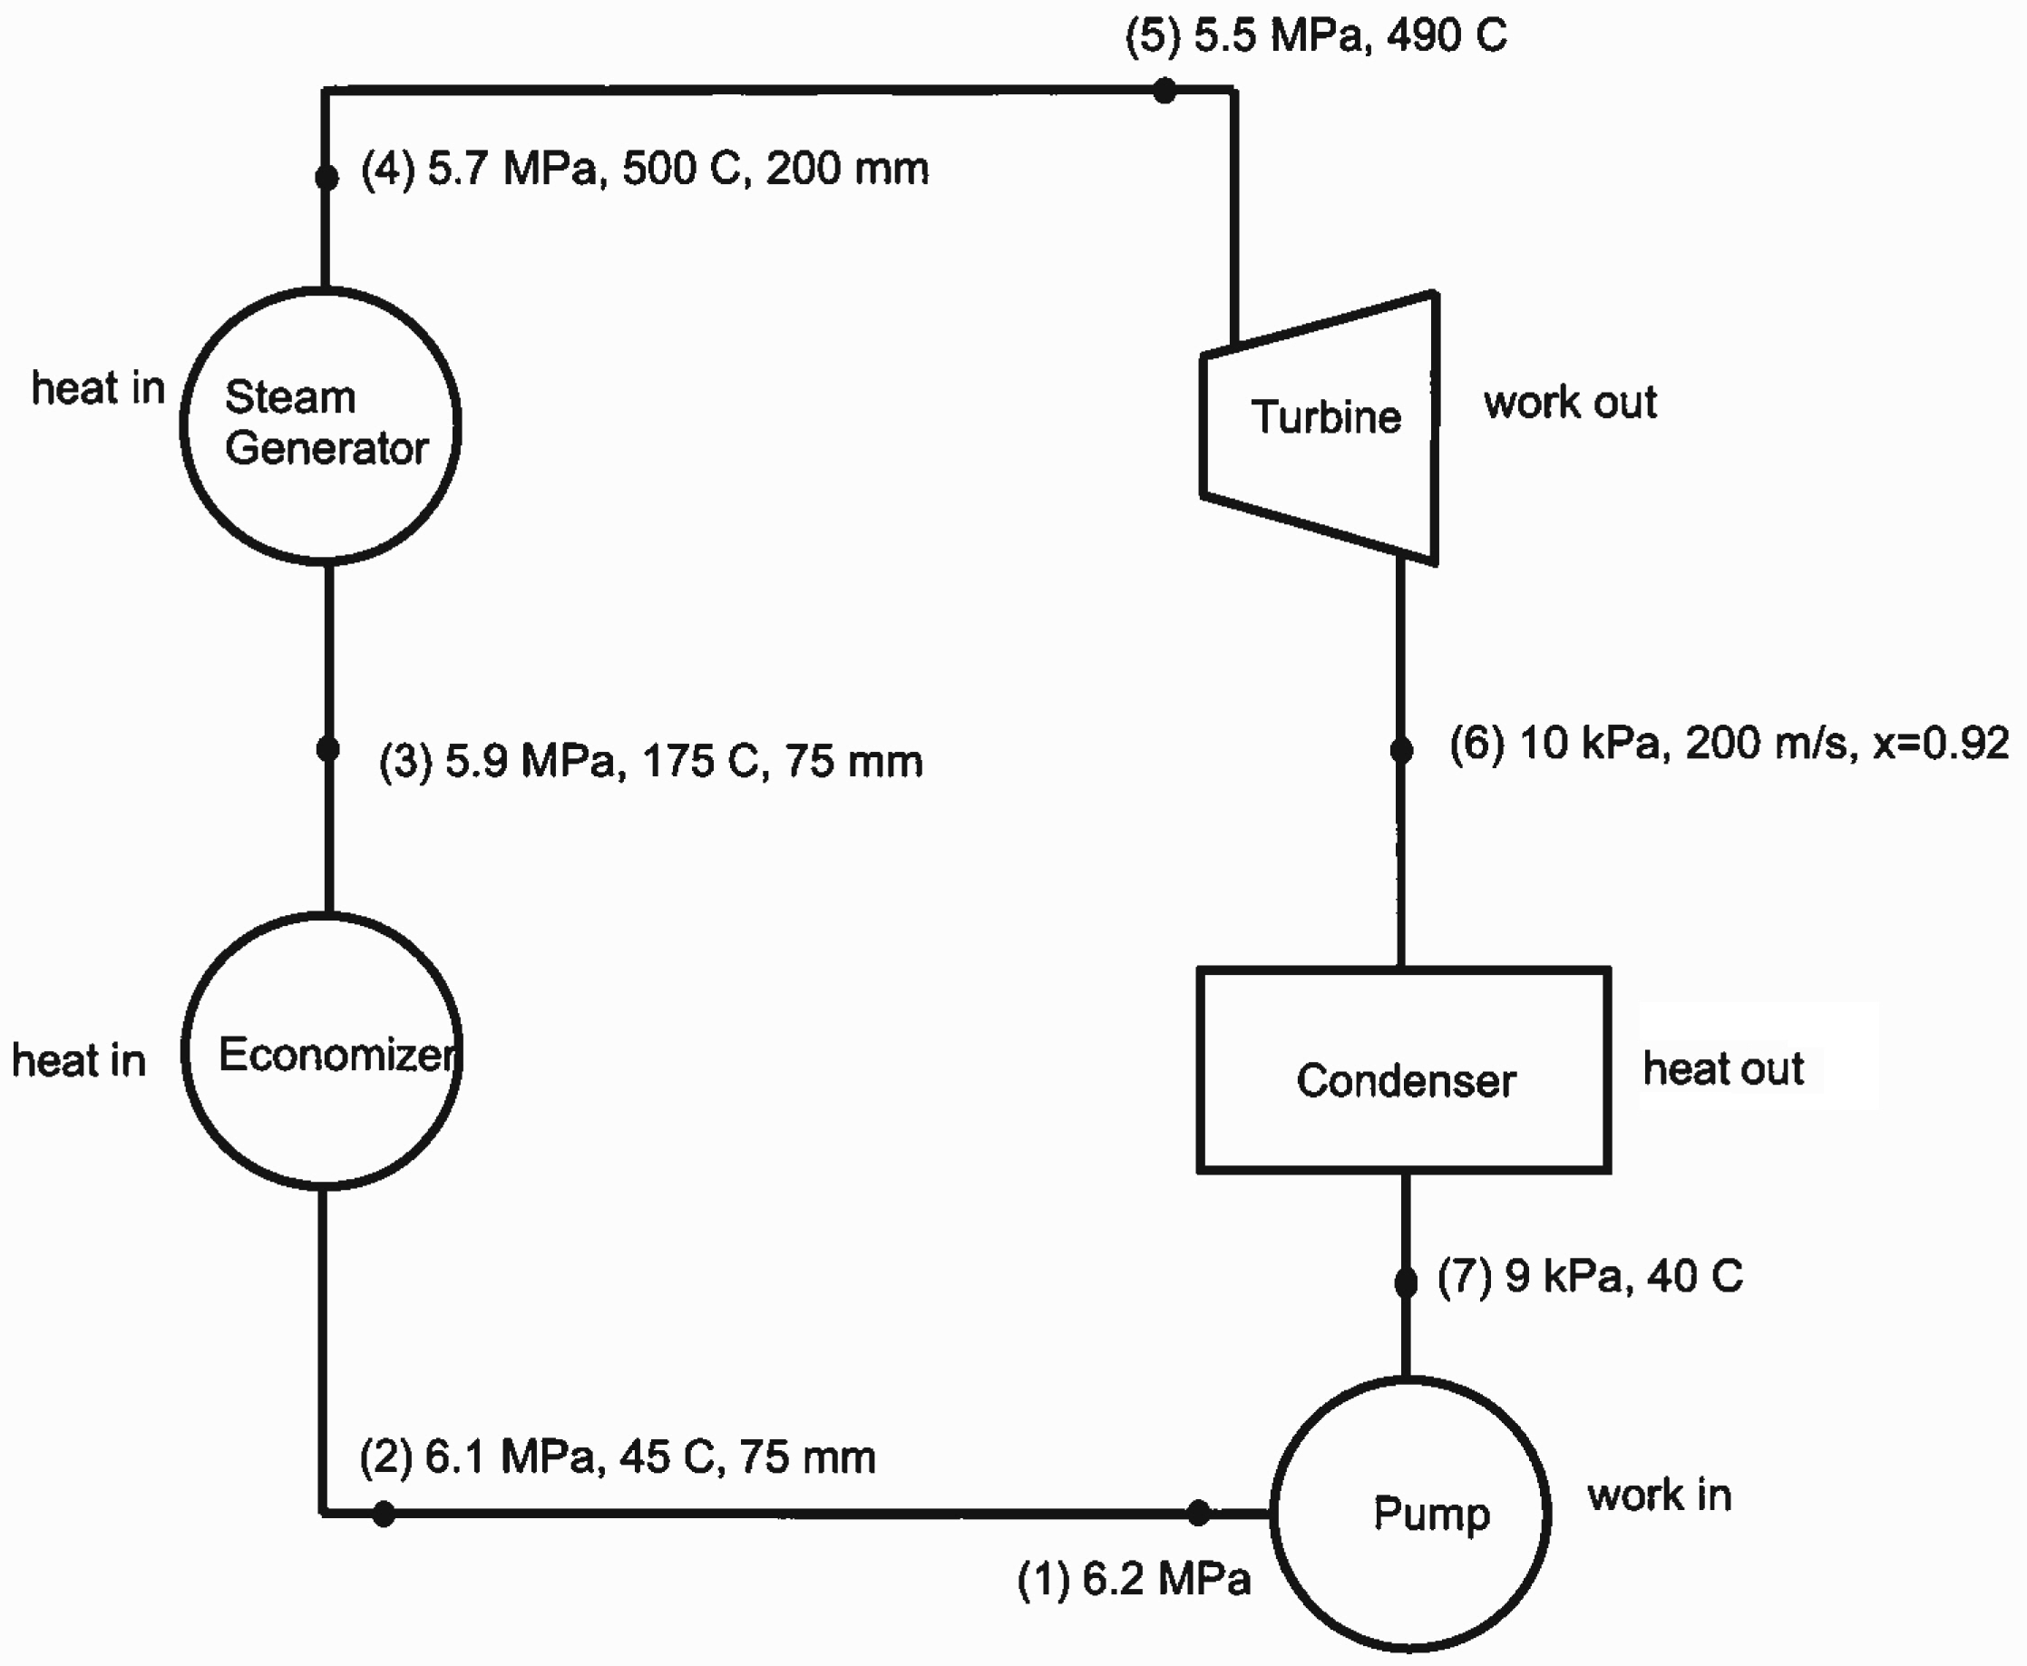

Analysis of a Typical Power Cycle
Notes:
Want to find the pipe diameter at 6

Slide 3
Analysis of a Typical Power Cycle
c) Determine the diameter of pipe connecting turbine to the condenser.

Slide 4
Analysis of a Typical Power Cycle
Notes:
Look at state 5 and state 6

Slide 5
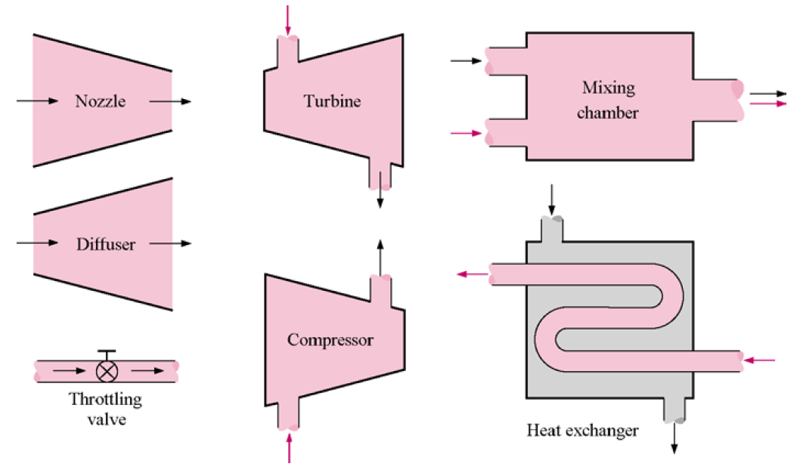
Some Steady-Flow Engineering Devices
Below are some engineering devices that operate essentially as SSSF processes:

Slide 6
What is a condenser?
Compressor
Throttling device
Mixing chamber
Heat exchanger
Diffuser
Notes:
1 minute to think

Slide 7
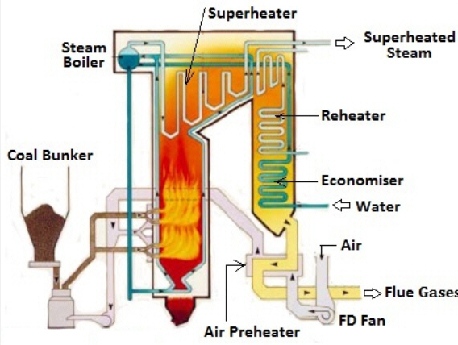
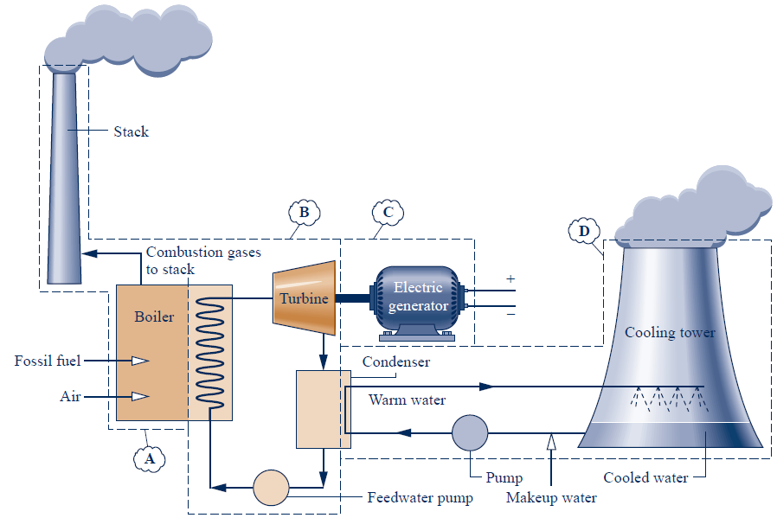
Analysis of Typical Power Cycle

Slide 8
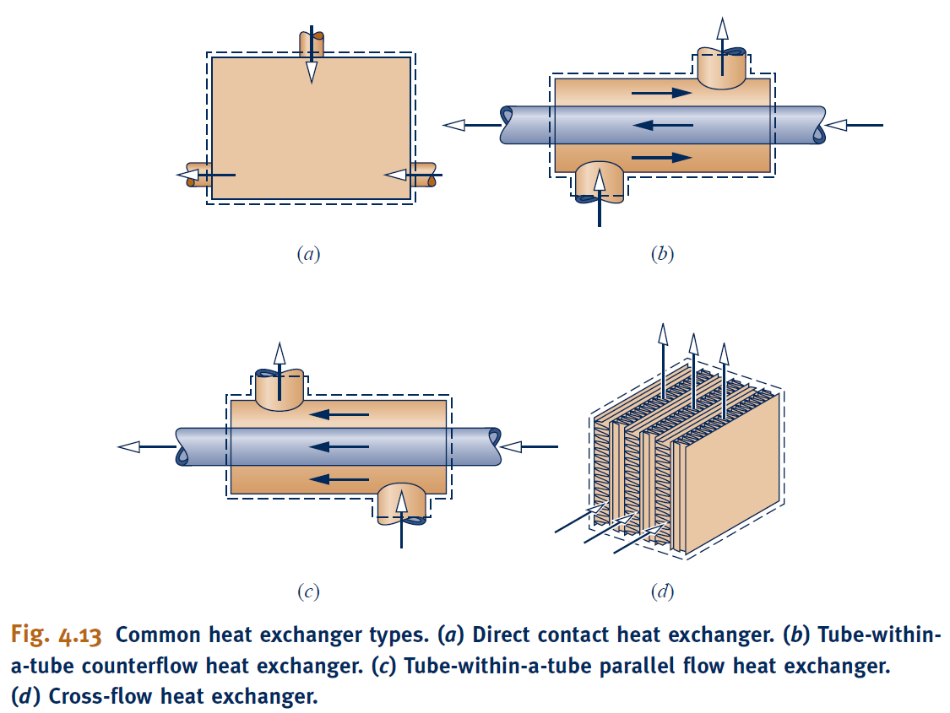
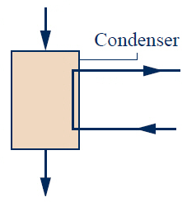
Analysis of Typical Power Cycle
d) Flow rate of cooling water through the condenser if the temperature of the cooling water increases from 15 ºC to 25 ºC.
⑥
b
a
⑦
Notes:
Cross flow and counter flow heat exchanger.

Slide 9
Analysis of Typical Power Cycle
d) Flow rate of cooling water through the condenser if the temperature of the cooling water increases from 15 ºC to 25 ºC.
⑥
b
a
⑦
Which is the most likely design for a condenser?
Notes:
30 seconds to think

Slide 10
Analysis of Typical Power Cycle
d) Flow rate of cooling water through the condenser if the temperature of the cooling water increases from 15 ºC to 25 ºC.
⑥
Assumptions for non-mixed heat exchanger:
No work transfer.
Steady state
Negligible heat loss.
Neglect changes in PE and KE.
Lumped analysis is sufficient.
Properties are defined at inlets to both fluid streams.
b
a
⑦

Slide 11

Analysis of Typical Power Cycle
d) Flow rate of cooling water through the condenser if the temperature of the cooling water increases from 15 ºC to 25 ºC.
⑥
C.V. #1
b
$$\dot{Q}$$
a
⑦

Slide 12
Analysis of Typical Power Cycle
d) Flow rate of cooling water through the condenser if the temperature of the cooling water increases from 15 ºC to 25 ºC.
C.V. #2
⑥
b
a
⑦

Slide 13
Analysis of a Typical Power Cycle
Notes:
Efficiency

Slide 14
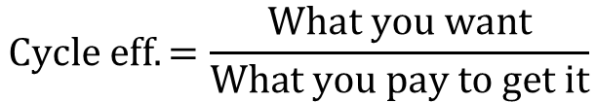
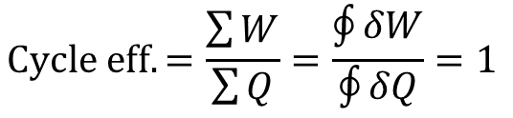
Analysis of a Typical Power Cycle
e) What is the “efficiency” of the cycle?
$$Cycle eff. =\frac{\sum{W}}{\sum{Q}}=\frac{\oint{δW}}{\oint{δQ}}=1$$
X
$$Cycle eff. =\frac{What you want}{What you pay to get it}$$
Notes:
Most efficient power plant is around 60%. 30% is not a very good one.
More than one hour to do a full hour. Make a mistake, the mistake continues onwards.

